Slide 1
Navigating on Complex 3D Surfaces
Nick Miller, Trevor Harron, Charles Boudousquie
7/18/19

Slide 2
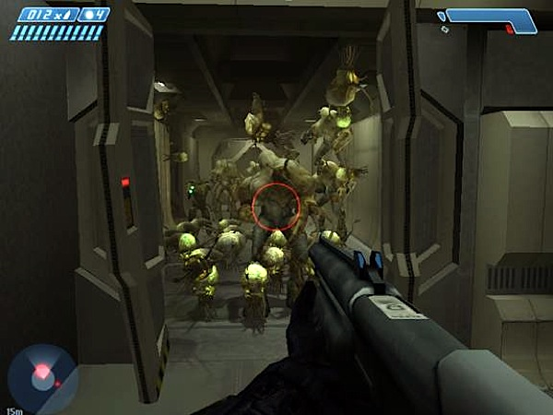
Notes:
Who remembers this scene in Halo?
The flood bursts through the door, and it was unsettling and terrifying because they could run up the walls. We wanted to implement something just like this.

Slide 3
What was our Goal?
To implement agents that can efficiently navigate the surface of any 3D model
Notes:
calling it gecko ai

Slide 4
Navigating on Complex 3D Surfaces
Generate the Navmesh
Adapt the Funnel Algorithm
Implement Agent Behavior

Slide 5
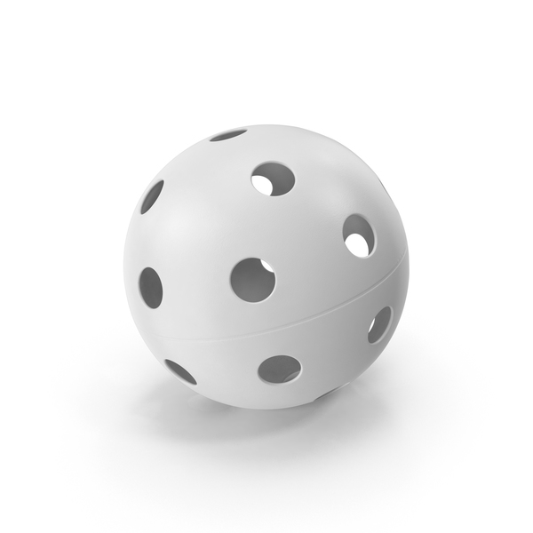
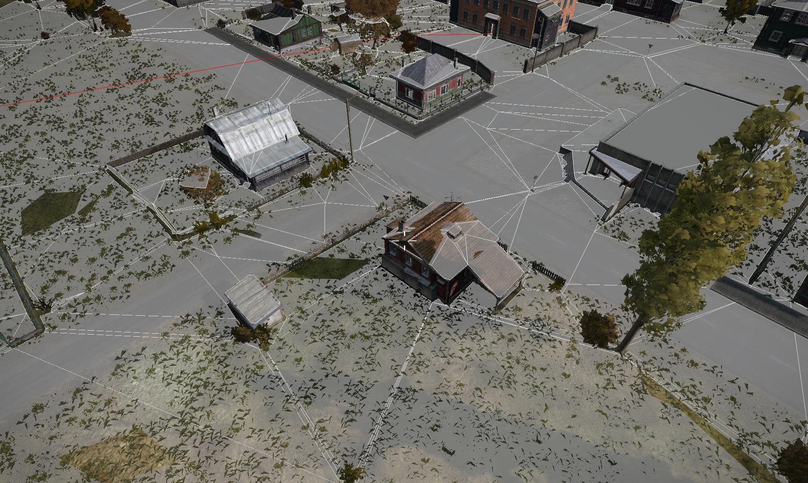
Converting a Surface into a Navmesh
So how did we handle this?
Convert the Surface into triangles
Calculate the node’s geometry
Find the node’s the neighbors
pixelsquid.com
We’ve got this down!
Notes:
Before we get to the 3D Funneling, we need to have a navmesh that allows us to navigate a complex shape.
Most navmeshes like the one unity can generate are designed for 2D Funneling and a (generally) flat 2.5D navigable surface
So we built our navmesh based on the Unity Mesh object and comprised that mesh of nodes containing the needed positional and directional information
This allowed us to ensure not only the correct movement of the agents but also give us the needed information for terrain analysis The Terrain analysis simply analyzes the players postions and the camera direction reletive to each node to determine the node visibility and distance

Slide 6
Navigating on Complex 3D Surfaces
Generate the Navmesh
Adapt the Funnel Algorithm
Implement Agent Behavior

Slide 7
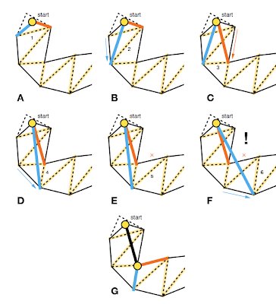
Understanding the funnel algorithm
Source: Stupid Simple Funnel Algorithm by Mikko Mononen
Notes:
the funnel algorithm is actually very simple, so simple that out main source called it the stupid simple funnel algorithm
start with a navmesh path
(note we focus on the highlighted dotted line)
form a ‘wedge’ and check if the next point is within the within the wedge
if it is, ‘reduce’ the funnel by re-assigning one of the path’s points
if it isn’t, add the new point to the list of efficient path points and re-initialize the funnel

Slide 8
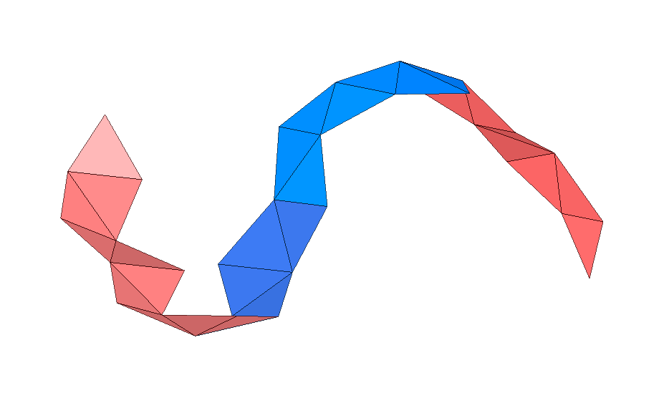
Can we apply the algorithm to a complex navmesh?
Notes:
describe my process for extrapolating in 3d

Slide 9
Extrapolating the funnel algorithm
Get starting line from normal
Get funnel planes from node intersections
Check if next point is in funnel
Set new starting line or reduce funnel
Project onto surface
Notes:
we adapted the funnel algorithm using the following steps
note normal of starting node, visualize it as a dotted line
select shared points like with funnel algorithm
take difference of (funnel boundary) and (closest point on normal line to funnel boundary)
use these points to define a ‘funnel’ with planes
check if next point is within the funnel using similar vector and add/reduce just like the normal algorithm
finally project the efficient path onto the surface of the mesh to get an efficient logical path

Slide 10
Navigating on Complex 3D Surfaces
Generate the Navmesh
Adapt the Funnel Algorithm
Implement Agent Behavior

Slide 11
Behavior Design
Get Distance to Player
Dist < 30
Dist >= 100
30 <= Dist < 50
50 <= Dist < 100
Fly Away
Wander
Look At Player
Hide
Waiting

Slide 12
Terrain analysis can free up resources
Store distance and visibility in layers
Update terrain analysis periodically with:
Distance from player
How visible the node is to the player

Slide 13
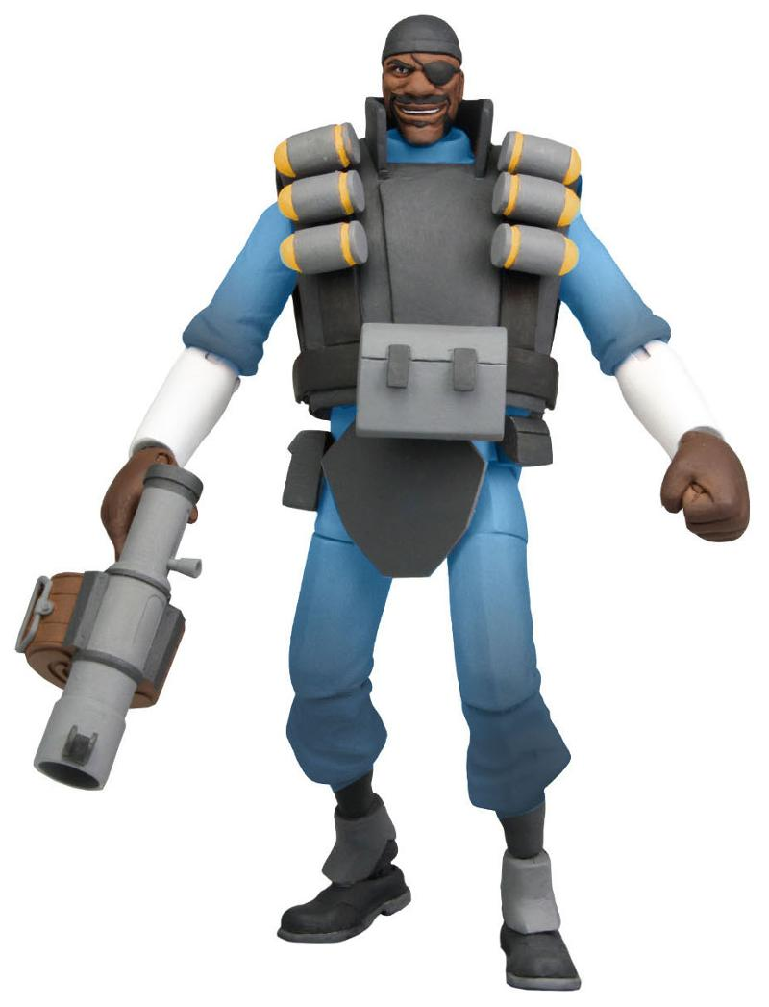
Seeing is believing
Notes:
It’s Demo Time

Slide 14
Questions/Comments

